Slide 1

Applications of Vision and Language Models for Visual Surveillance
Presented By
Debi Prosad Dogra (dpdogra@iitbbs.ac.in)
Department of Computer Sc. & Engineering
https://secs.iitbbs.ac.in/index.php/dpdogra/
VISMA@CSE (https://visma-iitbbs-b3f86.web.app/)
Thanks to
Kamalakar, Shreetam, Arif, Lalit, Kamakshya, and KIST Team

Slide 2
Dealing with Anomalies! Vision-based Models
An action that deviates from regular behavior is considered to be unexpected and sensitive action for that environment.
In video surveillance, numerous abnormal behaviors are possible depending on camera settings, camera placements, recording perspectives, and interactions of real-world objects.
For examples, sudden dispersal of people, ignoring traffic signals, person falling suddenly while walking, fighting, kidnap, explosion, vandalism, and so on are considered to be abnormal or anomalous in nature depending on the context.

Slide 3
Dense Crowd
Physics based model for crowd dynamic analysis.
Crowd dynamics in terms of randomness and energy computed with the help of Gibbs entropy and Kinetic energy.
Video
Optical Flow Computation
Orientation Quantization
Connected Component Analysis
Energy and Entropy Calculation
Analysis

Slide 4
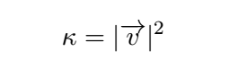
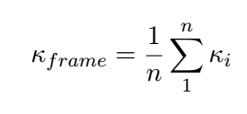
Dense Crowd Characterization based on Gibbs Entropy
Energy Calculation: Energy of a pixel (moving point) can be approximated by velocity of a pixel in motion using optical-flow.
Average energy of an image frame ($k_{frame}$) is calculated over all pixels across all groups using,
where ($k_{i}$) represents the energy of the ith pixel in motion in the frame.

Slide 5
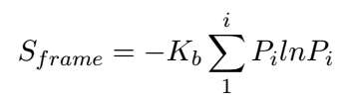
Dense Crowd Characterization based on Gibbs Entropy
Entropy Calculation:
Considering each connected-component as a microscopic state and the frame as a macroscopic state, the entropy of the frame can be calculated using,
where K_{b} >= 1.0 and i represents the number of groups in a frame,
P_{i} denotes the probability distribution of the dominant angle of the ith group in the frame.

Slide 6
Observations
If significant fluctuations are observed in inter-frame energy, it can be attributed to a fast moving crowd with higher velocity.
If the fluctuations in inter-frame energy difference are low, then the crowd can be assumed to be moving at a uniform but lesser velocity.
Similarly, more fluctuations in the entropy curve indicate varying randomness in the crowd.
For constant entropy, the randomness can be assumed to be less in a video.

Slide 7
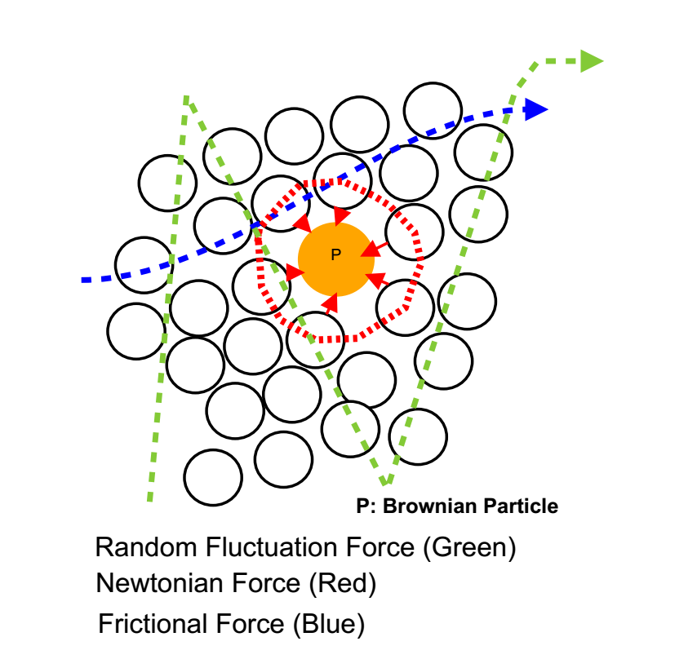
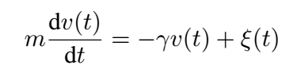
Flow Segmentation: Langevin Equation
Langevin Equation:: Background and Foundation
is perhaps the simplest way to describe the
dynamics of non-equilibrium systems.
where γ(t) is the frictional coefficient and
ξ(t) is the random force arises due to random
density fluctuation in the fluid.

Slide 8
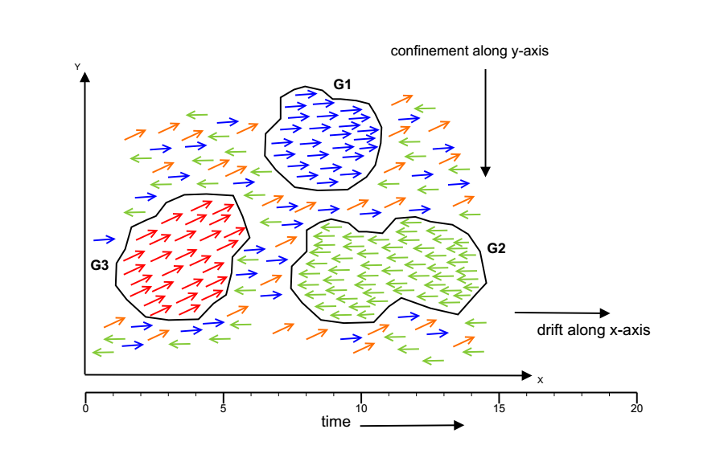
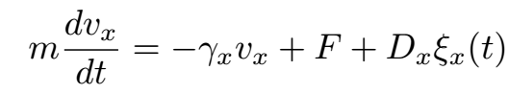
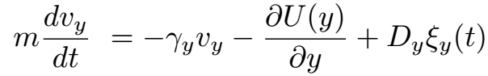
Flow Segmentation: Langevin Equation

Slide 9
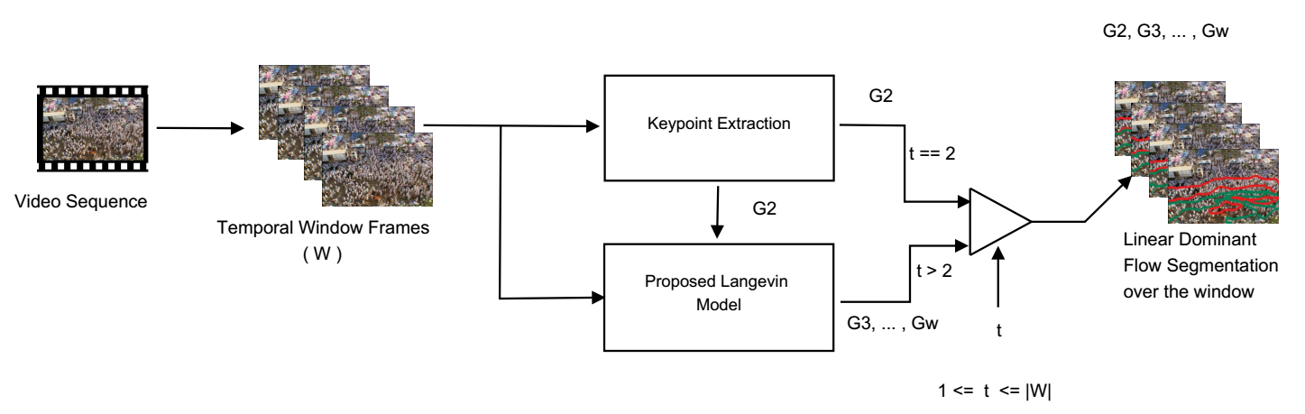
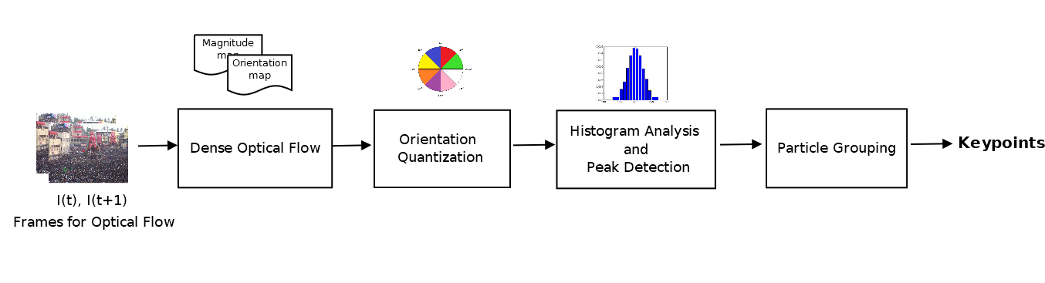
Flow Segmentation: Langevin Equation

Slide 10
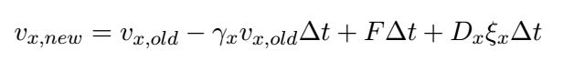
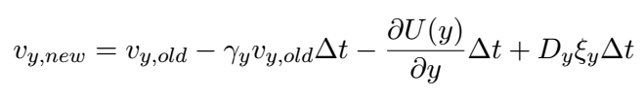
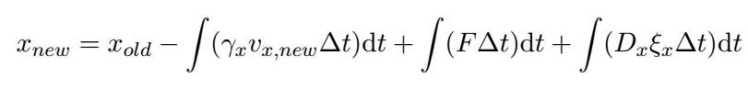
Flow Segmentation: Langevin Equation
Velocity Estimation
Position Estimation

Slide 11
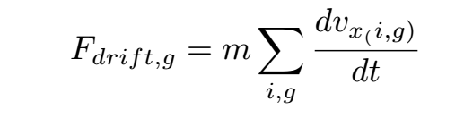
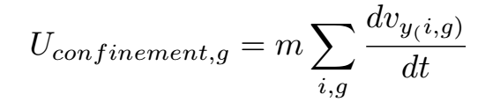
Flow Segmentation: Langevin Equation
where m : mass of the particle,
γ_{x} : resistive force due to particles
and groups in the surrounding
F : constant drift force
U : confinement force
D_{x} & D_{y} : Strength of the noise
ξ_{x} & ξ_{y} : Random force due to random
density fluctuations in the
considered group
v_{x(i;g)} & v_{y(i;g)} : Velocities for the ith key-point
in the gth group along x-axis
and y-axis, respectively.

Slide 12
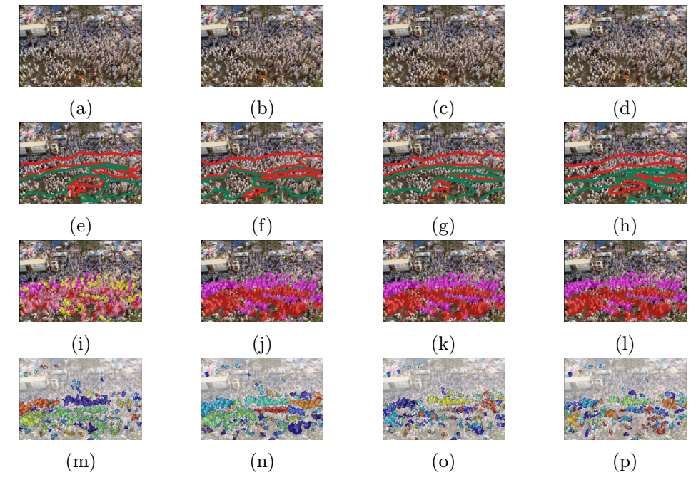
Flow Segmentation: Results
(a-d) Original recorded Frames (41-44) of the Fair video (e-h) Ground Truth Frames, (i-l) represents segmented output obtained Langevin Model (m-p) represents output of segmentation (Ali et al.)

Slide 13
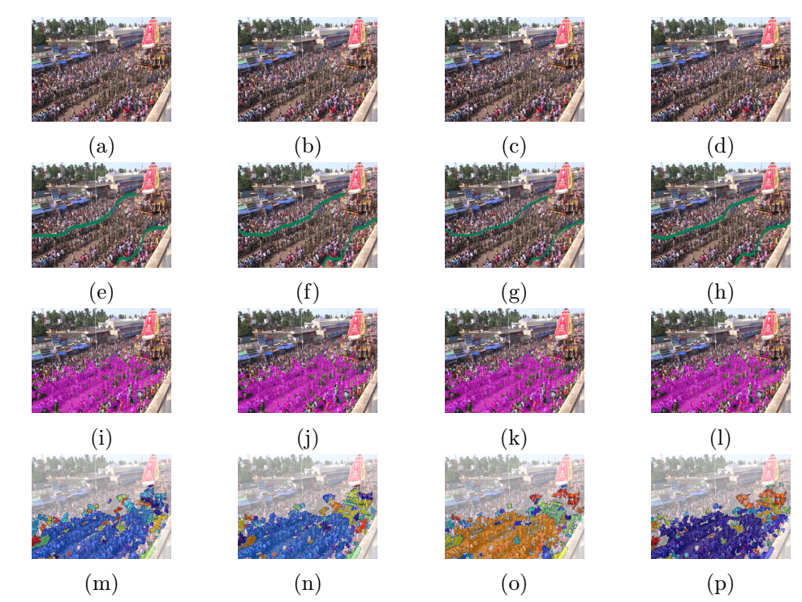
Flow Segmentation: Results
(a-d) Original recorded Frames (31-34) of the Rath Yatra video (e-h) Ground Truth Frames, (i-l) represents segmented output obtained using Langevin Model (m-p) represents output of segmentation using (Ali et al.)

Slide 14
Anomaly Detection
For visual surveillance, security agencies often install thousands of surveillance cameras.
It is not possible to monitor the huge amount of long-duration video data manually.
Moreover, manual processing is time-intensive and error prone.
Hence automatic detection and recognition of abnormal events using computer vision is a good option.
3 Key Points: Anomalies are (i) Rare, (ii) Short-duration, and (iii) Disguise in long hours data.

Slide 15
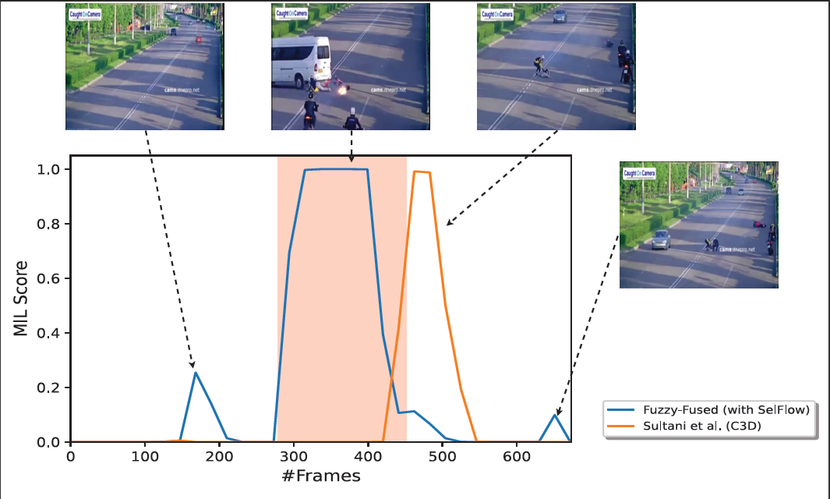
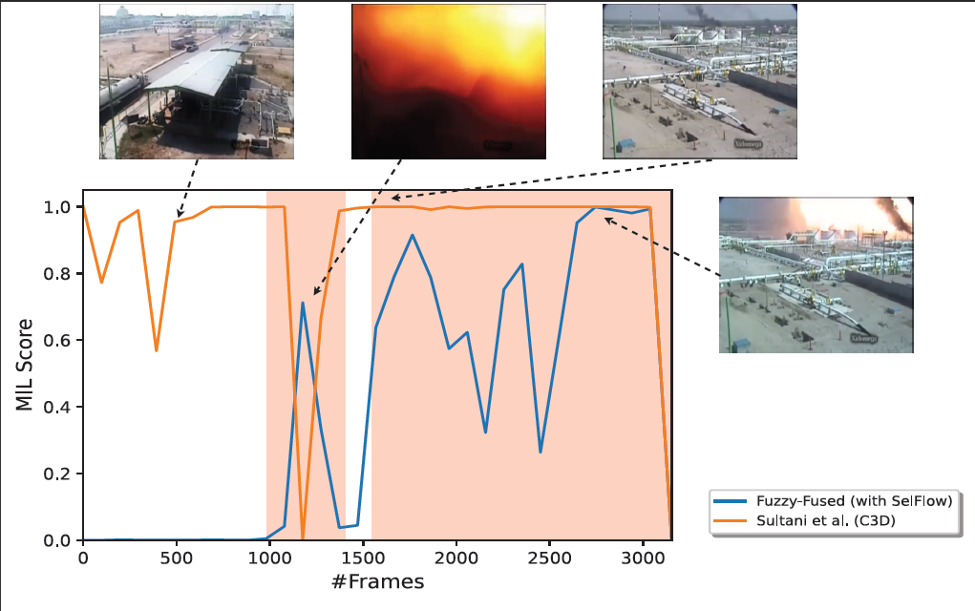
Detection

Slide 16
Handling Anomalies: Unsupervised Way

Slide 17
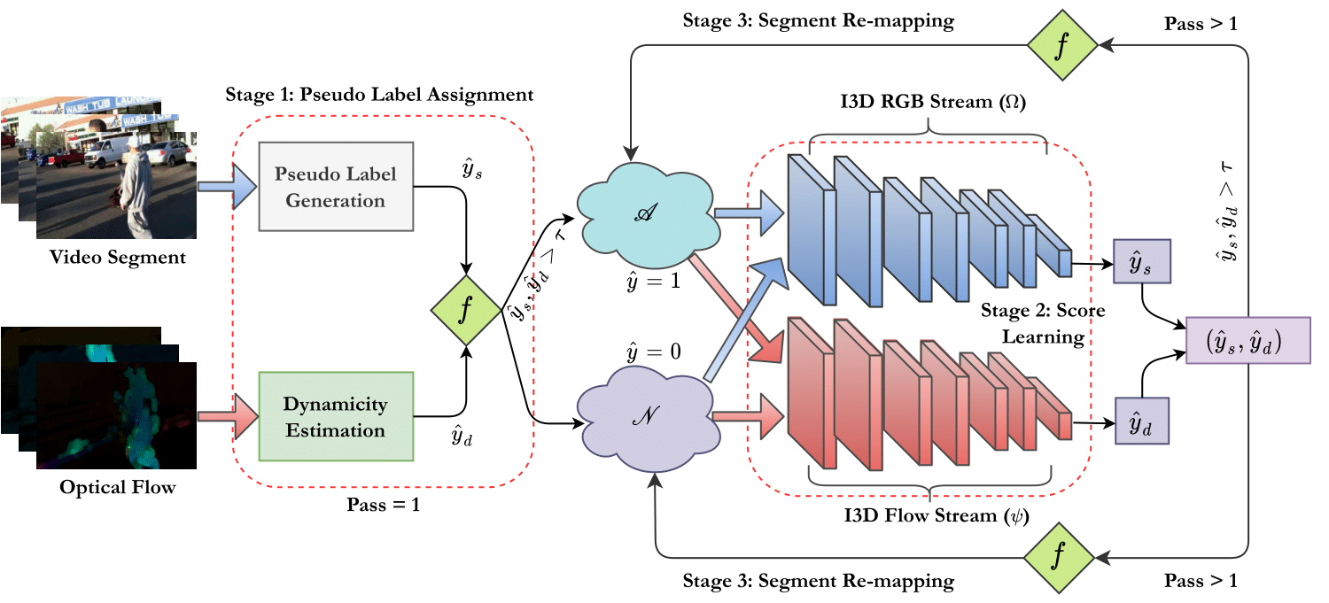
Dynamicity Driven Model
WACV’24

Slide 18
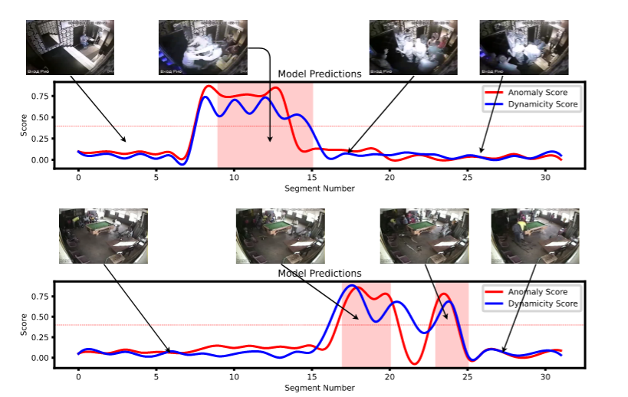

Slide 19
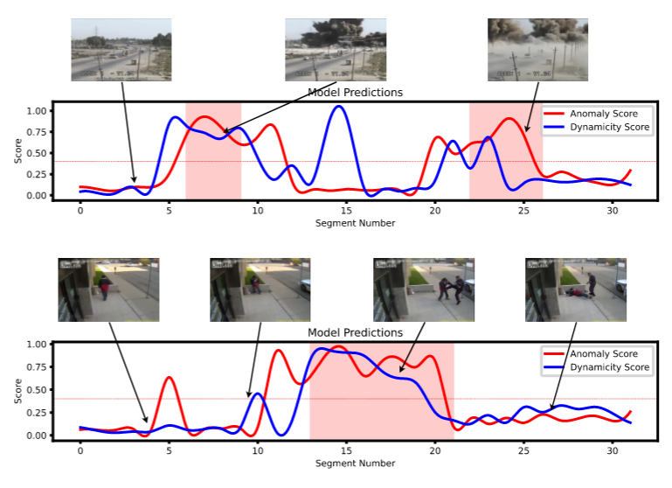

Slide 20
Object Interactions and Anomalies

Slide 21
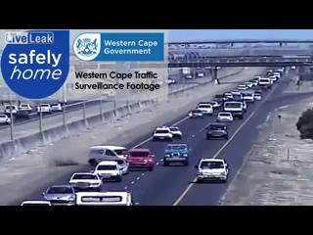
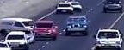
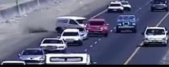


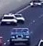
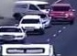
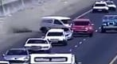
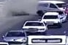
K-body Interactions
Original Frame
Different Proposals

Slide 22
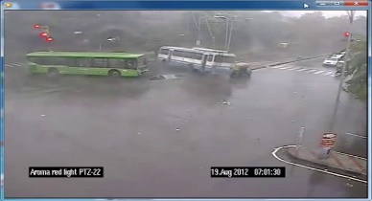
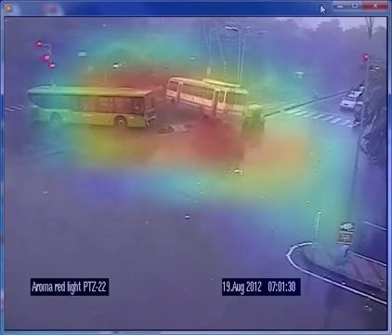
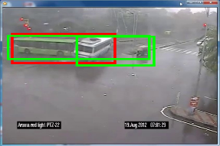
Can Object-Object Interactions Help?
Bag of Positive Proposal
K-body Interaction
Proposal
Refinement Algorithm
Bag of Negative Proposal
BoN
BoP
Input Video
Source: “K-Body Proposal…”, IEEE ITS, 2022
HeatMap using
CAM[9]
MobileNet Classifier[11]
Proposal Features
Context Analysis
Frame-Level
Localization
Proposal Labels

Slide 23
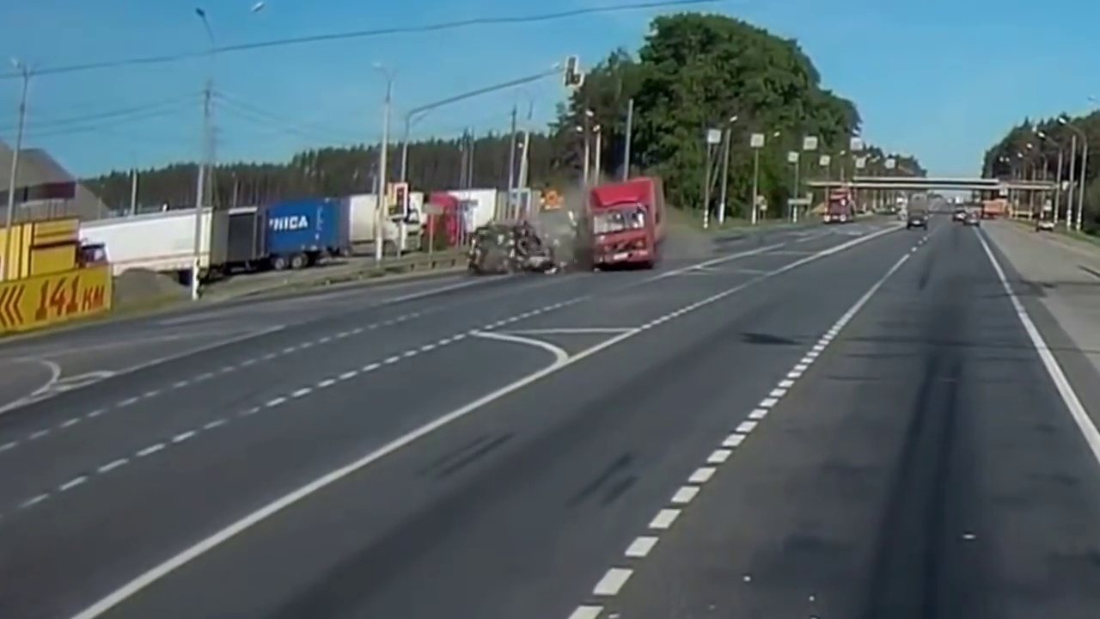

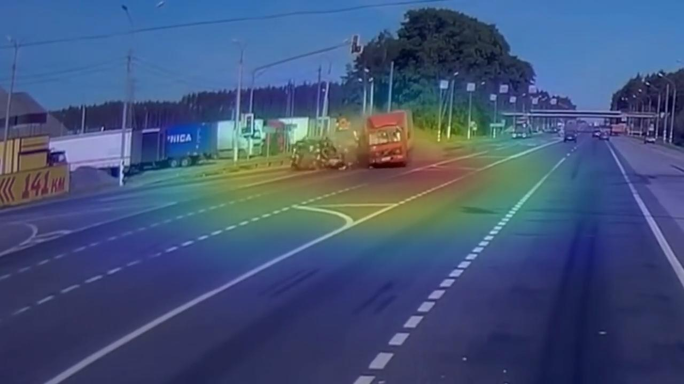
Localization

Slide 24
Real-world and Synthetic Datasets

Slide 25
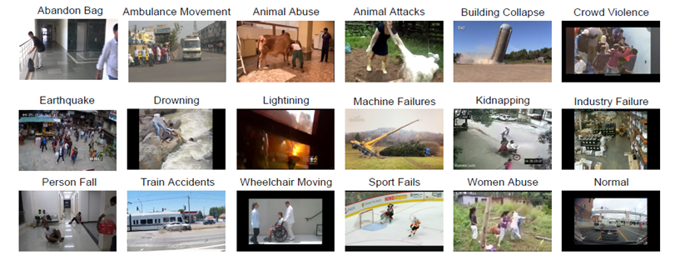
RareAnom Dataset (PR’2023)

Slide 26
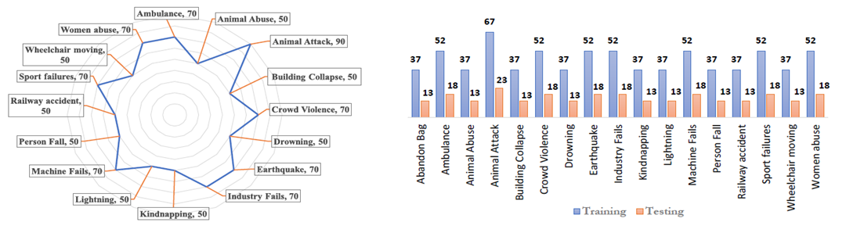
RareAnom: Statistics

Slide 27
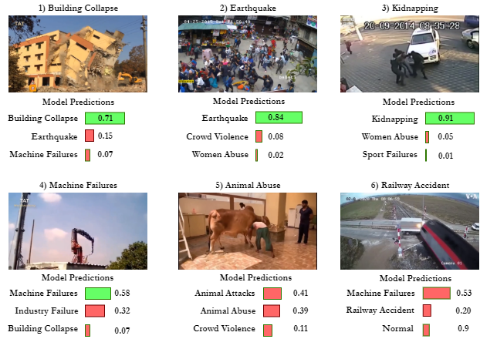
Success and Failures!

Slide 28
Multiple Views MP-RAD

Slide 29
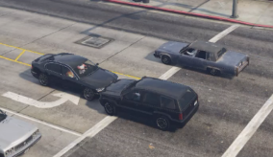
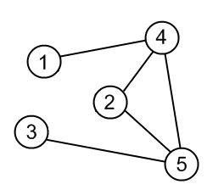
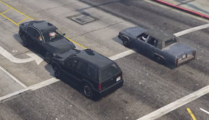
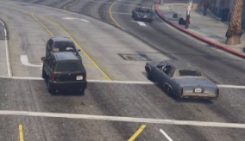
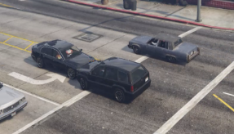
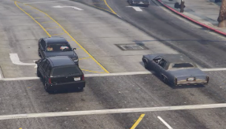
Feature Similarity
Confusion Matrix
Spatio-Temporal Feature Extractor
……..
Angle-1
……..
Angle-2
Angle-3
Spatio-temporal Feature Similarity Estimation
Weight Sharing Decision
Pooling
……..
Angle-4
……..
Angle-5
……..
IEEE T-ITS’22

Slide 30
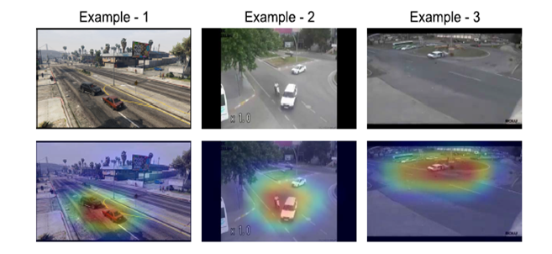
Class Activation Mapping

Slide 31
Other Surveillance Applications! Vision-Language-based Models

Slide 32
Pedestrian Attribute Recognition (PAR)
Pedestrian attribute recognition aims to predict multiple attributes for one pedestrian image.
A few example of attributes but not limited to age, clothes, camera view (front, back, side), accessories like bag, mobile, etc.
Various researchers have attempted Person re-identification [1], Person Retrieval [2], and Scene Understanding [3] using Pedestrian attribute analysis.

Slide 33

PAR Research Advancement
What is PAR? Why it is so important?
What’s the problem?
And what can be the solution?
PEARL Dataset
Hierarchical Transformers-based Approach
CLIP-Based Approach
ICPR’24

Slide 34
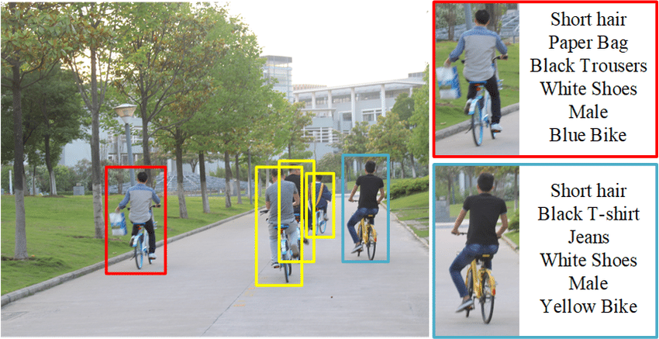
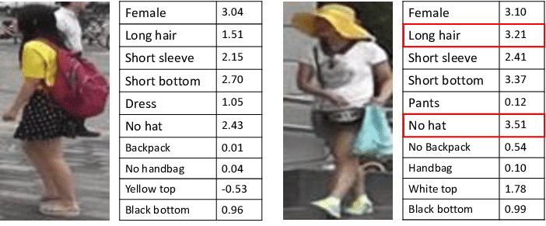
Pedestrian Attribute Recognition (PAR)
Source: [5]
Source: [4]

Slide 35
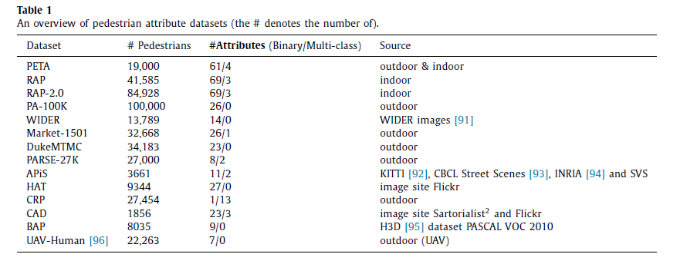
Existing PAR Datasets
Source: [5]

Slide 36
PAR Dataset Limitations
Few attributes dominate the annotations and may lead to overfitting.
Few instances consists of two pedestrians in a single image leaving annotator in confusing state.
Few attributes do not have a sufficient count to be included in the experiment.
Few datasets have redundant entries for the same pedestrian.
Few attributes have been misclassified.
Few datasets did not consider “NO” (Not Observable) option.

Slide 37
The PEARL Dataset
New Dataset
Large Scale
High Diversity
Not Observable
Partial Occlusion
Complex Variations
Sufficient Samples
Lesser Dominance
Various Locations
Different whether condition
(Sunny, Night, Rainy and Snowy)
3. No redundant samples
Include “NO” option
to each attribute
2. Model predict NO
if not predictable.
Include occluded pedestrian
But NO for the occluded part.

Slide 38
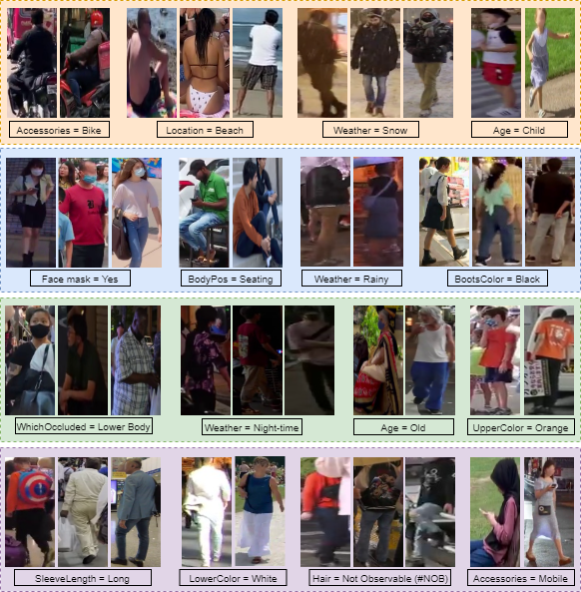
PEARL30K
PEARL (PEdestrian Attribute Recognition and Learning) consists of:
30,000 Pedestrian Samples,
25 wide-attributes categories,
146 attribute options, resulting 750,000 fine-grained annotations,
Spanning over 12 countries, four distinct weathers and 8 different public places.

Slide 39
Attribute Set
Sn. | Attribute Type | Attribute Values
1. | Gender | Male, Female, Other, NO#
2. | Age | Young, Teenager, Adult, Old, NO#
3. | Hair | Short, Long, Bald, NO#
4. | Hair Color | Black, Blonde, White, NA, Other, NO#
5. | Sleeve Length | No Sleeve, Short, Long, NA, NO#
6. | Viewpoint | Front, Left, Back, Side
7. | Is Occluded? | Yes, No
8. | Activity | Engaged in cellphone, Cycling, Pooling, Talking, Walking, Running, Standing, Seating, NO#
9. | Body Posture | Seating, Standing
10. | Which part Occluded? | Head-Shoulder, Lower body, Upper body, NA
11. | Hat | Yes, No, NO#
12 | Glasses | Yes, No, NO#

Slide 40
Attribute Set
Sn. | Attribute Type | Attribute Values
13. | Bag | Yes, No, NO#
14. | Bag Type | NA, Handbag, Backpack, Plastic Bag, Suitcase, Trolly, Shoulder-bag, Other, NO#
15. | Body Shape | Thin, Normal, Fat, NO#
16. | Upper Body Clothing | T-shirt, Shirt, Dress, Jacket, Suit, Coat, Sweater, Formal, No Cloth, Burqa, Saree, Other, NO#
17. | Upper Clothing Color | Black, White, Blue, Red, Green, Brown, Gray, Orange, Pink, Yellow, NA, Other, NO#
18. | Lower Body Clothing | Shorts, Jeans, Pants, Skirt, Burqa, Saree, Other, NO#
19. | Lower Clothing Color | Black, White, Blue, Red, Green, Brown, Gray, Orange, Pink, Yellow, NA, Other, NO#
20. | Boots | Yes, No, NO#
21. | Boots Color | Black, White, Blue, Gray, Other, NA, NO#
22. | Facemask | Yes, No, NO#
23. | Weather | Sunny, Night, Rainy, Snowy, NO#
24. | Height | Short, Medium, Tall, NO#
25. | Accessories | Bag, Trolly, Umbrella, Nothing, Bicycle, Bike, Other, NO#

Slide 41
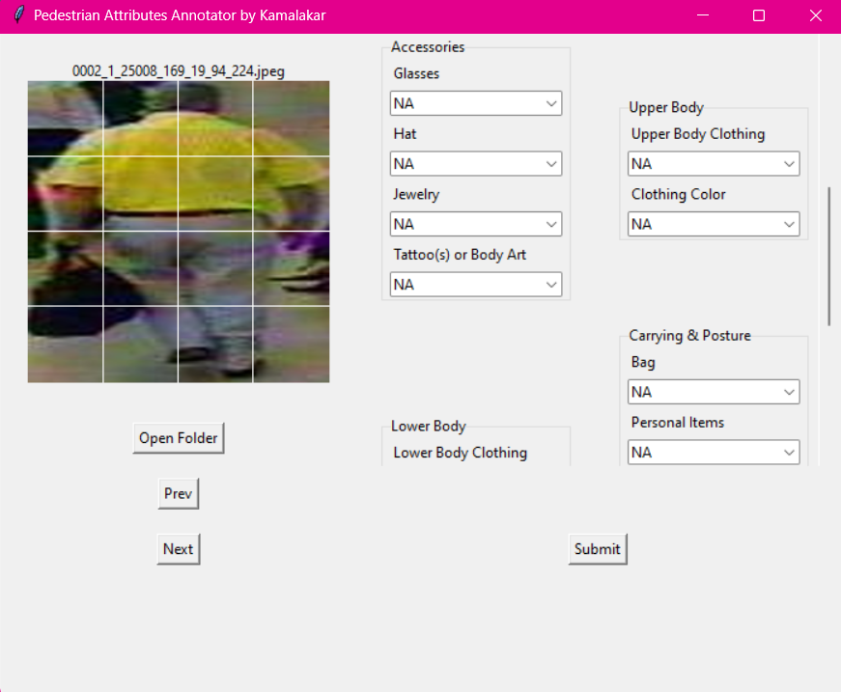
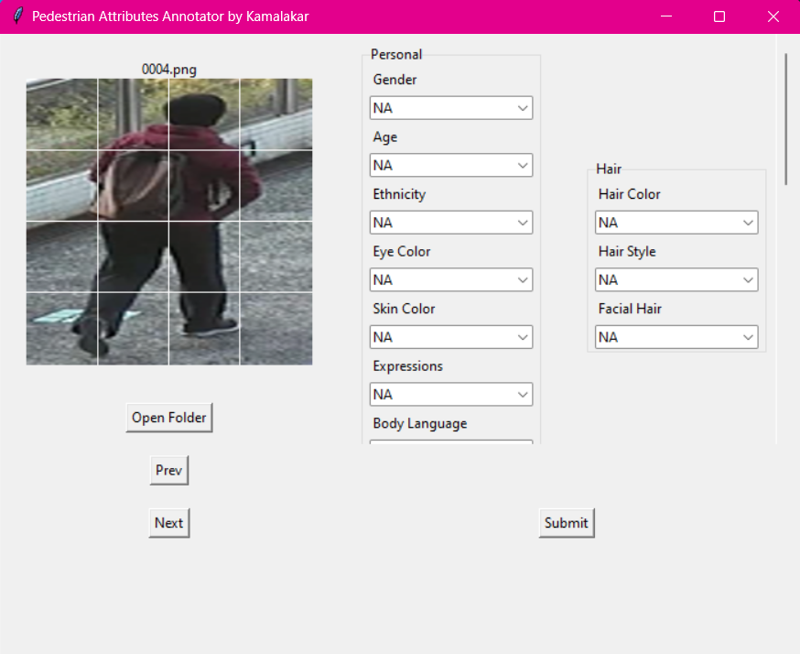
Annotation Tool

Slide 42

CLIP-Based Architecture

Slide 43

Three Prompt Settings

Slide 44


SOTA Comparisons

Slide 45


Slide 46


Cross-dataset Training

Slide 47


Qualitative Analysis

Slide 48
Hierarchical VITs for PAR (ICPR’24)
Multiple appearances of the same attribute, adverse weather and lighting conditions restrict model generalization capability.
A Vision Transformer-based (ViT) approach that categorizes attributes into different spatial granularity levels and employs diverse patch formations to extract discriminative features.
The baseline has been extensively evaluated on the three popular PAR datasets, namely RAP, PA100K and PETA.

Slide 49
A handful of contextual factors influence the appearance of attributes; hence, attentive feature learning is essential in a PAR setting.
To achieve this, a series of ViT blocks may be applied for each granularity level. Each ViT block is basically a regular Transformer encoder.
Vision Transformer (ViT) is a good choice for its fewer training parameters than Swin-T, and default patch embedding for annotated image-based datasets.

Slide 50

A Glimpse of the Architecture

Slide 51
How To Implement?
Employ ViT-Base encoder block to extract features which is pre-trained on, say ImageNet-21k, at a resolution of 224 × 224.
The patch size can be set to 8 × 8, 8 × 8, and 16 × 16 for granularity levels L1, L2 and L3.
Varying (16, 8, and 8) consecutive ViT blocks for L1, L2 and L3 for level-wise feature extraction can be tried.

Slide 52


ICPR’24 Results

Slide 53


Qualitative Results

Slide 54
Take Away!
Pedestrian Attribute Recognition is important in terms of security – surveillance.
PAR can be used for the Group-ReiD, Person-ReID, Personal Retrievals or scene understanding.
Data imbalances is inherited problem in PAR.
CLIP-based model can be used a detector if one able to convert ground truths into textual descriptions.

Slide 55
References
[1] Lin, Y.; Zheng, L.; Zheng, Z.; Wu, Y.; Hu, Z.; Yan, C.; and Yang, Y. 2019. Improving person re-identification by attribute and identity learning. Pattern Recognition.
[2] D. Li, Z. Zhang, X. Chen and K. Huang, "A Richly Annotated Pedestrian Dataset for Person Retrieval in Real Surveillance Scenarios," in IEEE Transactions on Image Processing, vol. 28, no. 4, pp. 1575-1590, April 2019, doi: 10.1109/TIP.2018.2878349.
[3] Jaderberg, M.; Simonyan, K.; Zisserman, A.; et al. 2015. Spatial transformer networks. In Advances in neural information processing systems, 2017–2025.
[4] Lin, Yutian & Zheng, Liang & Zheng, Zhedong & Wu, Yu & Yang, Yi. (2017). Improving Person Re-identification by Attribute and Identity Learning. Pattern Recognition. 95. 10.1016/j.patcog.2019.06.006.
[5] Wang, Xiao & Zheng, Shaofei & Yang, Rui & Bin, Luo & Tang, Jin. (2019). Pedestrian Attribute Recognition: A Survey.
[6] Y. Deng, P. Luo, C. C. Loy, X. Tang, "Pedestrian attribute recognition at far distance," in Proceedings of ACM Multimedia (ACM MM), 2014.

